Slide 1
Convolutional Encoder

Slide 2
Convolutional Encoder Structure
Parallel encoder cannot handle recursive filters.
Sliding Filter
Binary Data Input
b₀
b₁
b₂
m₁
m₂

Slide 3
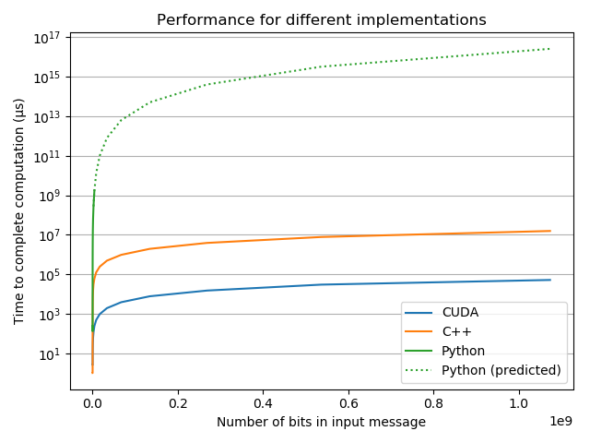
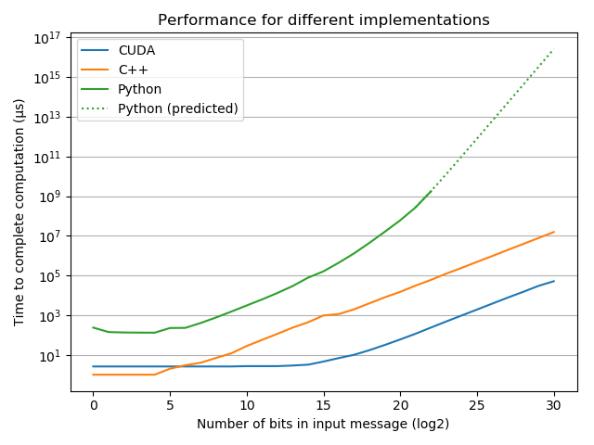
Performance

